Slide 1
Cyber Security in a School Context – what I know now!
Erica Thomas

Slide 3
Background
Critical incident for NGS Nov 2020
NGS had undergone a full cyber security review in July/ August 2020
Board had raised this as part of risk management

Slide 4
The Incident
Saturday 7 November – timing/ ( had been our system for up to 10 days before the incident)
Discovery and threat/ ransom – Over $1 million in crypto currency. Russian cyber criminals –same group who attacked Medibank
School could not function. All services out; email, phones, printers, gates, learning management system, data base, communication tools

Slide 5
Leading the response
School/ Role of Principal
Understand the situation – non technical/ Ethical position
Critical calendar impacts – HSC + Year 7 -10 exams
Consider whether the School is operational (NGS 24 hours)
Critical Incident Plan – team
Establish communication channel/ key messaging
Insurance broker (AON) – technical/ communications/ legal – specialist help
Police/ Federal Police/ Cyber crime reporting – no clear reporting lines ReportCyber | Cyber.gov.au (This is improving)
Student, parent, staff, IT team – management
Media
Data Breach?

Slide 6
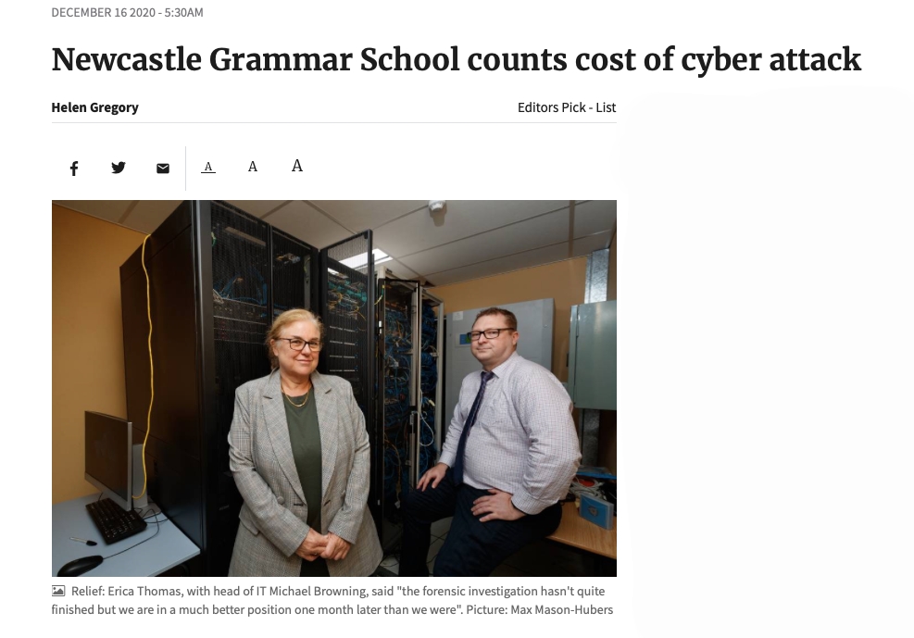
NGS Counts Cost of Cyber Attack
Newcastle Grammar School will find out this week if any of its data has been stolen, following a ransomware cyber attack which saw criminals encrypt and destroy part of its network.
Head of School Erica Thomas said having cyber insurance allowed the school to organise a team of specialists to fight and restore some of its system, begin a forensic investigation into whether data had been stolen, manage communication and look at any legal ramifications if there has been a data breach.

Slide 7
IT Response Response
First 24-72 hours
IT
Contacted threat actor to determine who/what/why? Dark web
Disable all internet links and isolate affected servers
Verify what backups available for restore
Consult with specialist IT and service providers as well as our providers
Build a recovery plan around available resources

Slide 8
IT Team’s Response
Following 4 weeks
Key Points:
Restore services that were available
Redesign services where necessary
Rebuild rather than restore where possible
Remove all possible threat vectors
Implement redesigned backup strategy

Slide 9
Long Term Impacts
Reputation: Build reputation
through honest communications,
Careful management
Data breach – moral v legal
obligation
Operational: Data loss,
Systems trust, staff training

Slide 10
Lessons for School Leaders
High level of vigilance – ongoing. This is not an IT problem.
Need more sophisticated monitoring – high cost
Understand how long it takes to download existing data
Staff training- ongoing
Critical incident scenario and policy: Work with Exec
Understanding this as a key risk/ fund staff training and IT processes and systems to protect/ Risk register

